Slide 1
CS4710: Artificial Intelligence Intro to Machine Learning
Let’s look at a couple more machine learning algorithms!

Slide 2

Topics
Another learning algorithm
Naïve Bayes Classifier
More Bayesian Networks!!

Slide 3
Naïve-Bayes Classifier

Slide 4
Naïve-Bayes Classifier
Another Classification Algorithm
Main Idea: Use a simple Bayesian Network (they’re back!) to do classification
Main Issues:
Need to build network from training set
A few important assumptions about features
Algorithm slightly different for discrete and continuous features

Slide 5
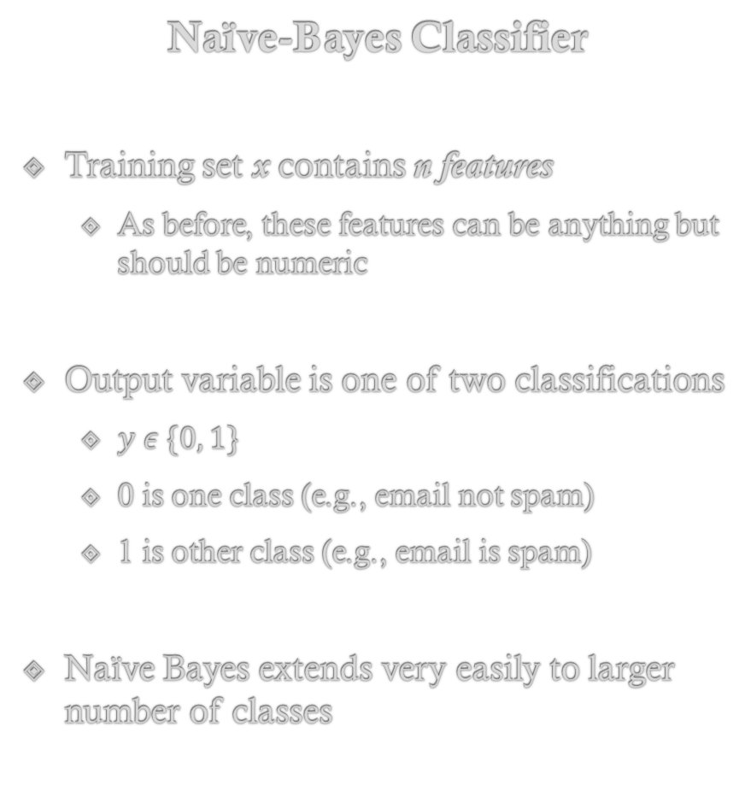
Naïve-Bayes Classifier
Training set x contains n features
As before, these features can be anything but should be numeric
Output variable is one of two classifications
$y ε \{0, 1\}$
0 is one class (e.g., email not spam)
1 is other class (e.g., email is spam)
Naïve Bayes extends very easily to larger number of classes

Slide 6
Naïve-Bayes Classifier
Treats learning as a probability estimation problem.
IDEA!: Set up the Bayesian Network as seen here
Our goal then is to predict:
P(Y = y_{i} | X = {x₁,x₂,…})
Y is the output variable
X is the set of evidence we are given by the example data row
Y (Output Variable)
X₁
X₂
X₃
…
X₄

Slide 7
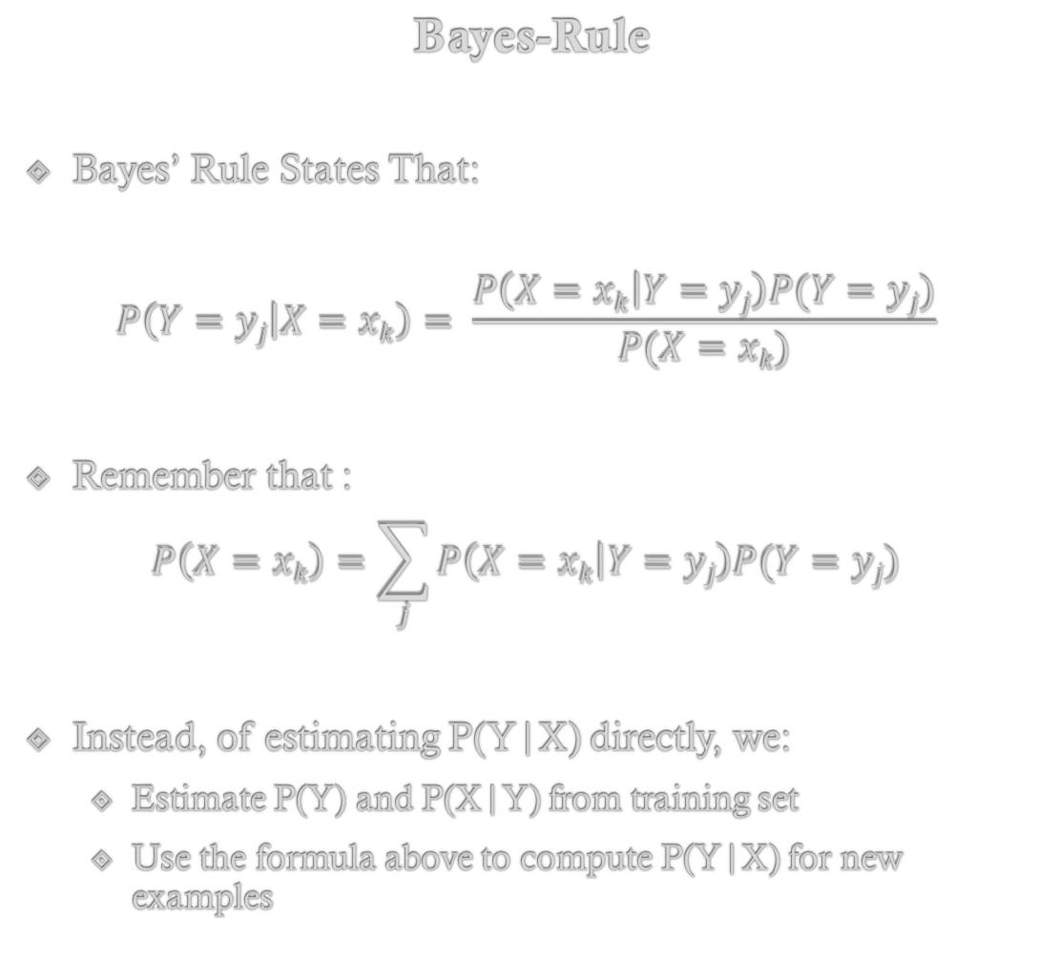
Bayes-Rule
Bayes’ Rule States That:
$$P\left(Y=yj | X=xk\right)= \frac{P\left(X=xk | Y=yj\right)P(Y=yj)}{P(X=xk)}$$
Remember that :
$$P\left(X=xk\right)=\sum_{j}{P\left(X=xk | Y=yj\right)P(Y=yj)}$$
Instead, of estimating P(Y|X) directly, we:
Estimate P(Y) and P(X|Y) from training set
Use the formula above to compute P(Y|X) for new examples
Y (Output Variable)
X₁
X₂
X₃
…
X₄

Slide 8
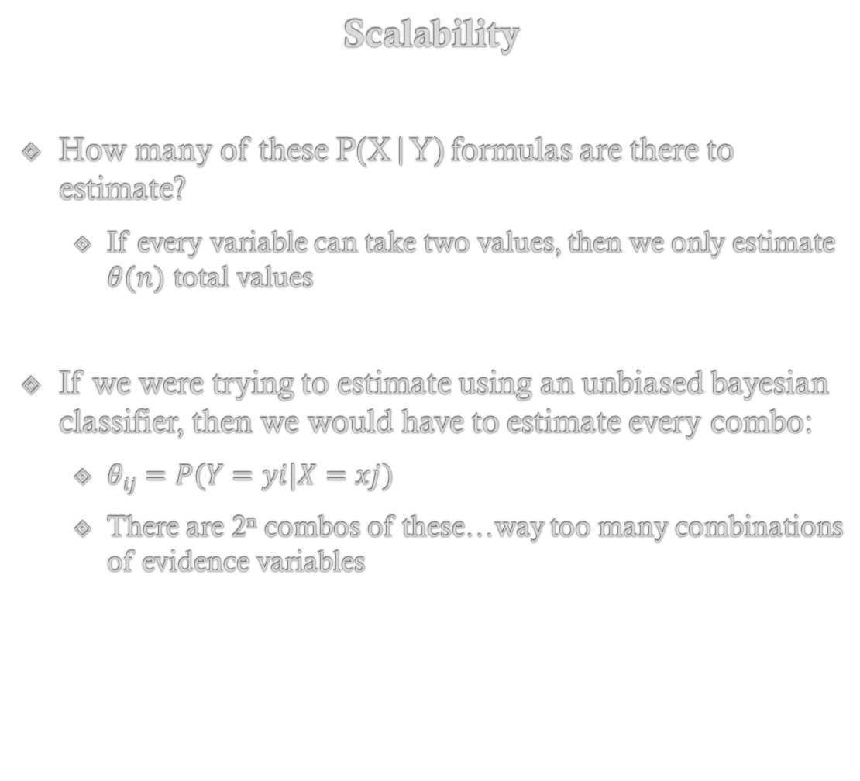
Scalability
How many of these P(X|Y) formulas are there to estimate?
If every variable can take two values, then we only estimate $θ(n)$ total values
If we were trying to estimate using an unbiased bayesian classifier, then we would have to estimate every combo:
$θij=P(Y=yi|X=xj)$
There are 2^{n} combos of these…way too many combinations of evidence variables
Y (Output Variable)
X₁
X₂
X₃
…
X₄

Slide 9
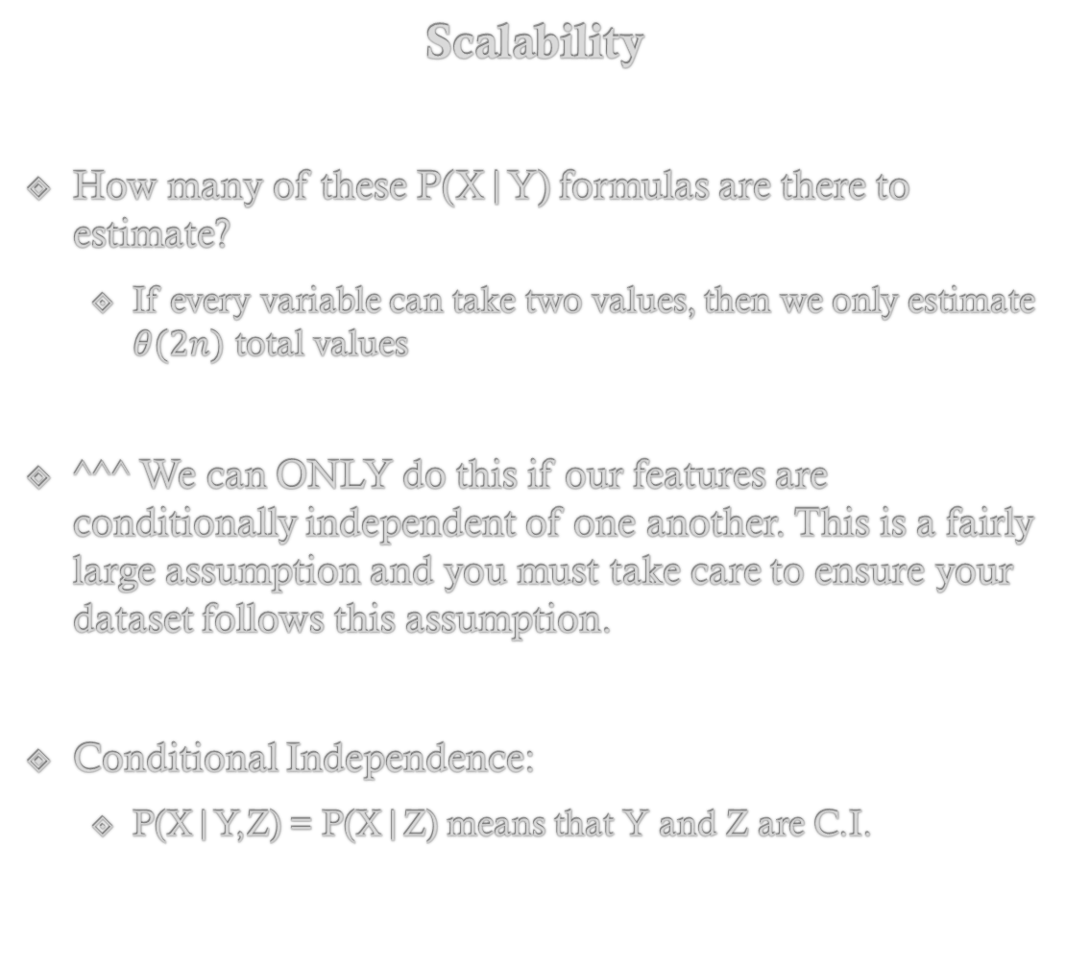
Scalability
How many of these P(X|Y) formulas are there to estimate?
If every variable can take two values, then we only estimate $θ(2n)$ total values
^^^ We can ONLY do this if our features are conditionally independent of one another. This is a fairly large assumption and you must take care to ensure your dataset follows this assumption.
Conditional Independence:
P(X|Y,Z) = P(X|Z) means that Y and Z are C.I.
Y (Output Variable)
X₁
X₂
X₃
…
X₄

Slide 10
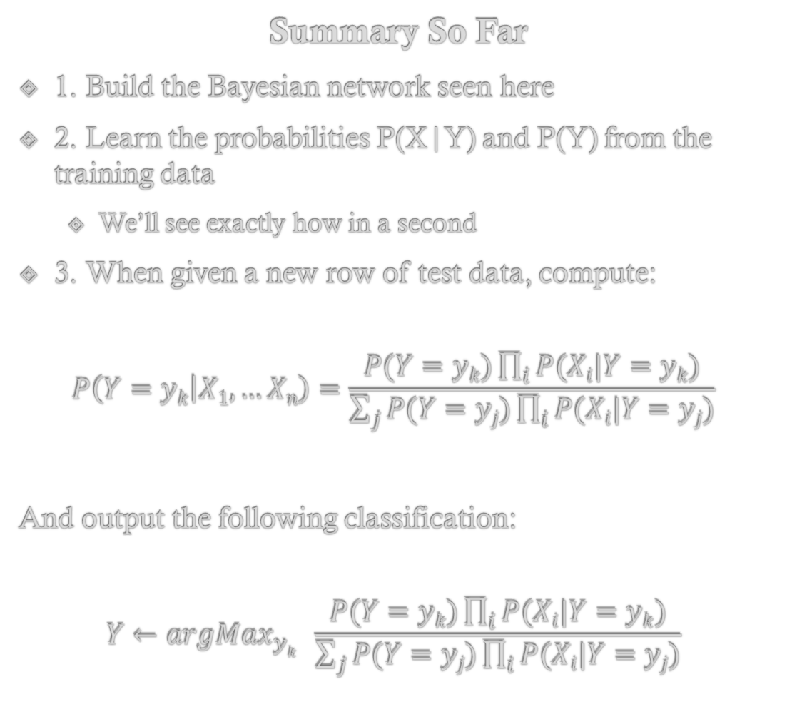
Summary So Far
1. Build the Bayesian network seen here
2. Learn the probabilities P(X|Y) and P(Y) from the training data
We’ll see exactly how in a second
3. When given a new row of test data, compute:
$$P\left(Y=yk | X1,…Xn\right)=\frac{P(Y=yk)\prod_{i}{P(Xi|Y=yk)}}{\sum_{j}{P(Y=yj)\prod_{i}{P(Xi|Y=yj)}}}$$
And output the following classification:
$$Y←argMax_{yk} \frac{P(Y=yk)\prod_{i}{P(Xi|Y=yk)}}{\sum_{j}{P(Y=yj)\prod_{i}{P(Xi|Y=yj)}}}$$
Y (Output Variable)
X₁
X₂
X₃
…
X₄

Slide 11
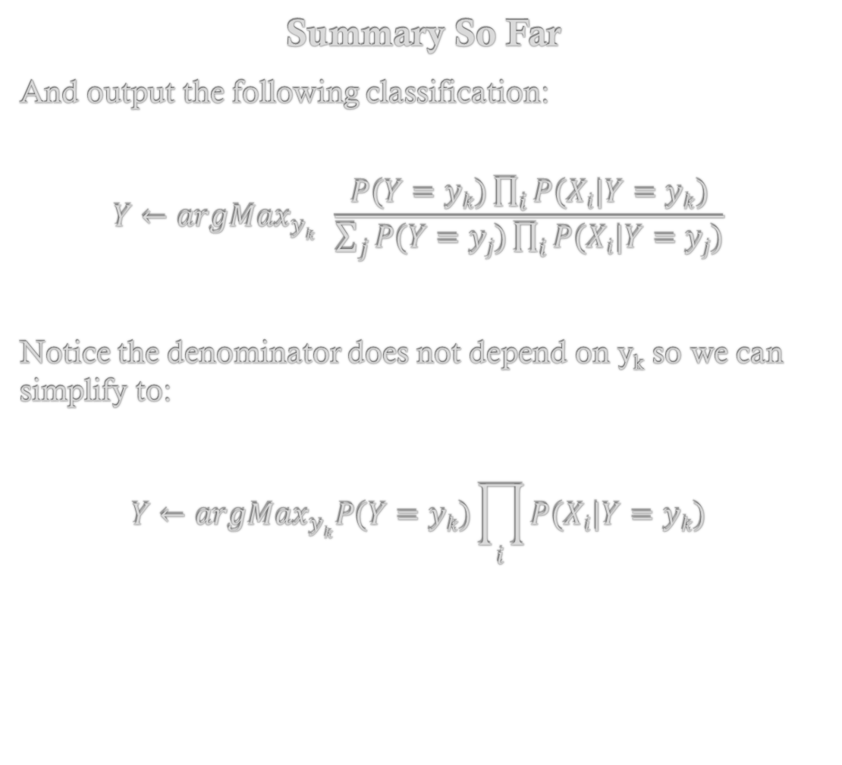
Summary So Far
And output the following classification:
$$Y←argMax_{yk} \frac{P(Y=yk)\prod_{i}{P(Xi|Y=yk)}}{\sum_{j}{P(Y=yj)\prod_{i}{P(Xi|Y=yj)}}}$$
Notice the denominator does not depend on y_{k} so we can simplify to:
$$Y←argMax_{yk}P(Y=yk)\prod_{i}{P(Xi|Y=yk)}$$
Y (Output Variable)
X₁
X₂
X₃
…
X₄

Slide 12
Naïve-Bayes Classifier
Learning the network probabilities: Discrete valued data

Slide 13
Summary So Far
The last piece is to show how to use the training data to learn the probabilities of interest:
P(Y)
P(X|Y)
When all of the data is discrete, this is quite simple.
Remember, discrete here means that each feature and output (Y) have a finite number of values they can take on.
Y (Output Variable)
X₁
X₂
X₃
…
X₄

Slide 14
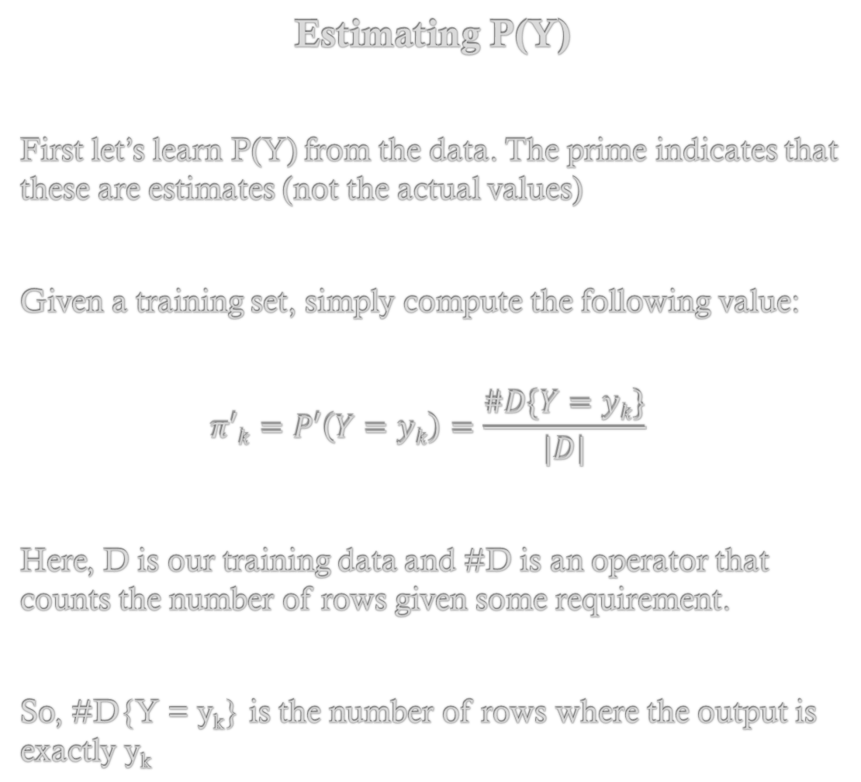
Estimating P(Y)
First let’s learn P(Y) from the data. The prime indicates that these are estimates (not the actual values)
Given a training set, simply compute the following value:
$$π′k=P′\left(Y=yk\right)=\frac{\#D\{Y=yk\}}{|D|}$$
Here, D is our training data and #D is an operator that counts the number of rows given some requirement.
So, #D{Y = y_{k}} is the number of rows where the output is exactly y_{k}
Y (Output Variable)
X₁
X₂
X₃
…
X₄

Slide 15
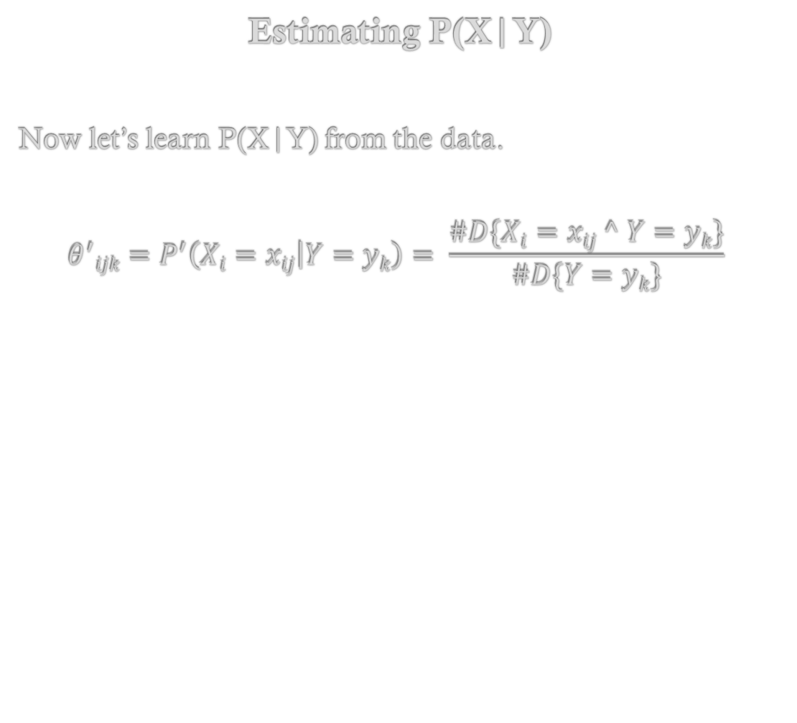
Estimating P(X|Y)
Now let’s learn P(X|Y) from the data.
$$θ^{′}ijk=P^{′}\left(Xi=xij | Y=yk\right)= \frac{\#D\{Xi=xij ^ Y=yk\}}{\#D\{Y=yk\}}$$
Y (Output Variable)
X₁
X₂
X₃
…
X₄

Slide 16
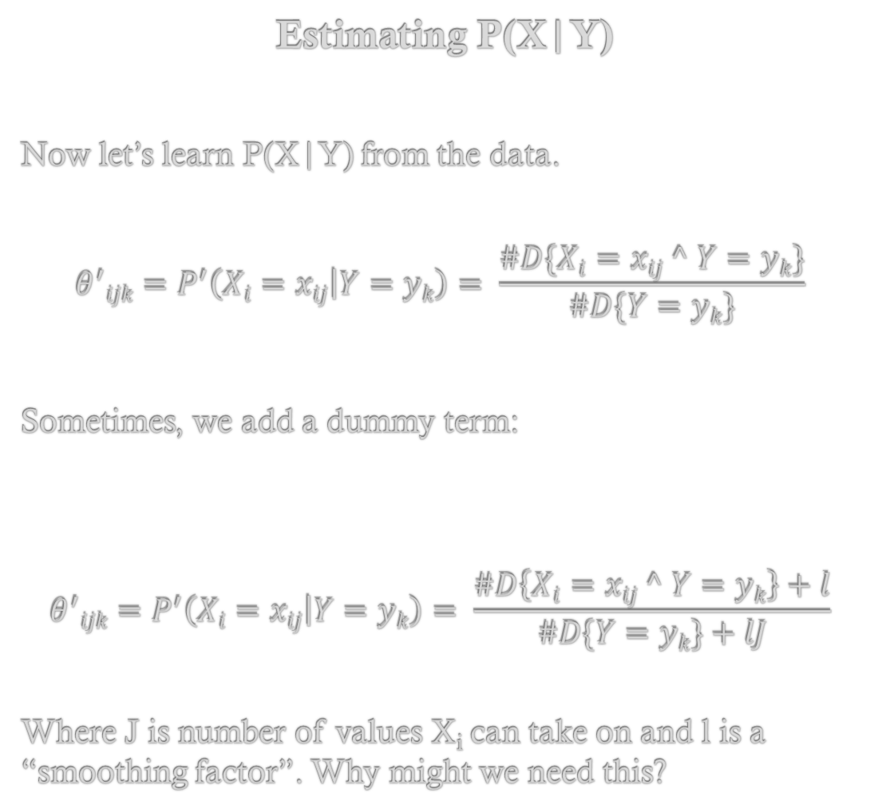
Estimating P(X|Y)
Now let’s learn P(X|Y) from the data.
$$θ^{′}ijk=P^{′}\left(Xi=xij | Y=yk\right)= \frac{\#D\{Xi=xij ^ Y=yk\}}{\#D\{Y=yk\}}$$
Sometimes, we add a dummy term:
$$θ^{′}ijk=P^{′}\left(Xi=xij | Y=yk\right)= \frac{\#D\left\{Xi=xij ^ Y=yk\right\}+l}{\#D\{Y=yk\}+lJ}$$
Where J is number of values X_{i} can take on and l is a “smoothing factor”. Why might we need this?
Y (Output Variable)
X₁
X₂
X₃
…
X₄

Slide 17
Naïve-Bayes Classifier
Learning the network probabilities: Continuous Valued Data

Slide 18
Continuous Features
The last piece is to show how to use the training data to learn the probabilities of interest:
P(Y)
P(X|Y)
When features are continuous, this is slightly more complicated.
Short version:
Instead let’s estimate the mean and std. dev. of each
We can compute probability density function from this
Y (Output Variable)
X₁
X₂
X₃
…
X₄

Slide 19
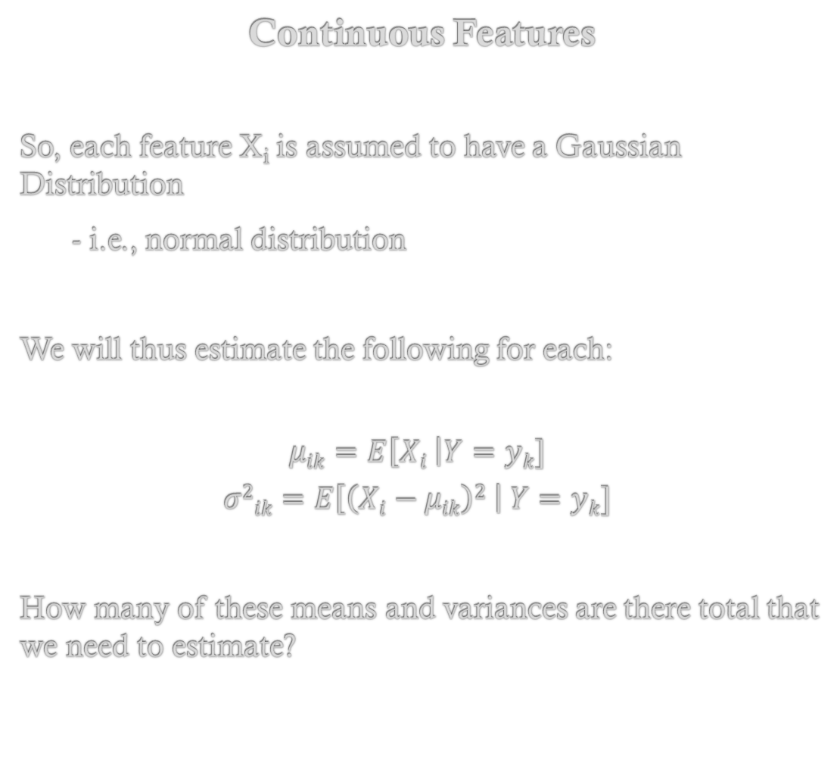
Continuous Features
So, each feature X_{i} is assumed to have a Gaussian Distribution
- i.e., normal distribution
We will thus estimate the following for each:
$$μik=E\left[Xi \right|Y=yk]$$
$$σ2ik=E\left[\left(Xi−μik\right)2 \right| Y=yk]$$
How many of these means and variances are there total that we need to estimate?
Y (Output Variable)
X₁
X₂
X₃
…
X₄

Slide 20
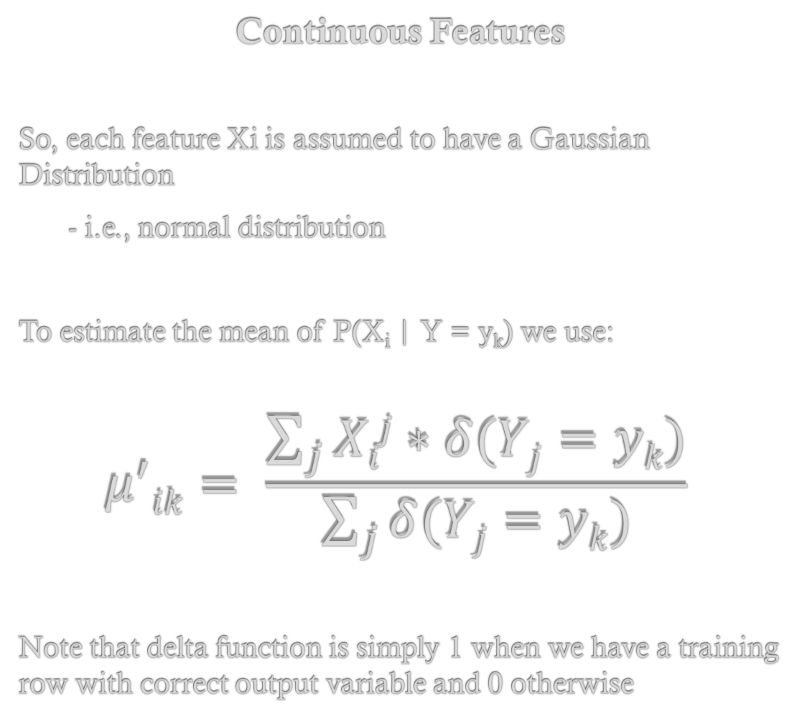
Continuous Features
So, each feature Xi is assumed to have a Gaussian Distribution
- i.e., normal distribution
To estimate the mean of P(X_{i} | Y = y_{k}) we use:
$$μ^{′}ik= \frac{\sum_{j}{Xij∗δ(Yj=yk)}}{\sum_{j}{δ(Yj=yk)}}$$
Note that delta function is simply 1 when we have a training row with correct output variable and 0 otherwise
Y (Output Variable)
X₁
X₂
X₃
…
X₄

Slide 21
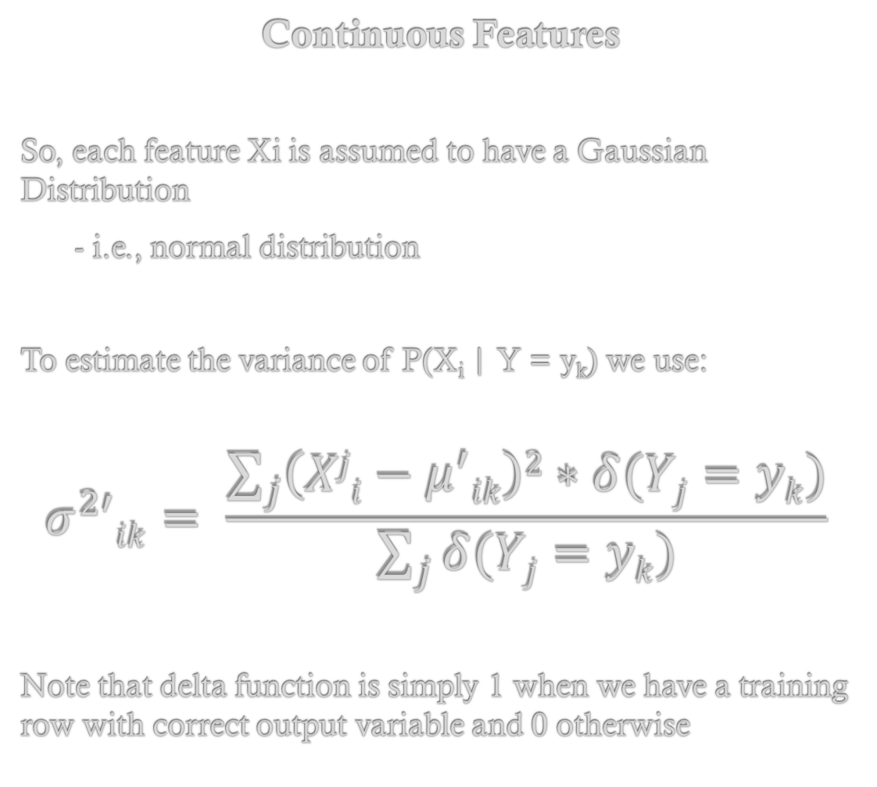
Continuous Features
So, each feature Xi is assumed to have a Gaussian Distribution
- i.e., normal distribution
To estimate the variance of P(X_{i} | Y = y_{k}) we use:
$$σ^{2′}ik= \frac{\sum_{j}{\left(Xji−μ^{′}ik\right)2∗δ(Yj=yk)}}{\sum_{j}{δ(Yj=yk)}}$$
Note that delta function is simply 1 when we have a training row with correct output variable and 0 otherwise
Y (Output Variable)
X₁
X₂
X₃
…
X₄

Slide 22
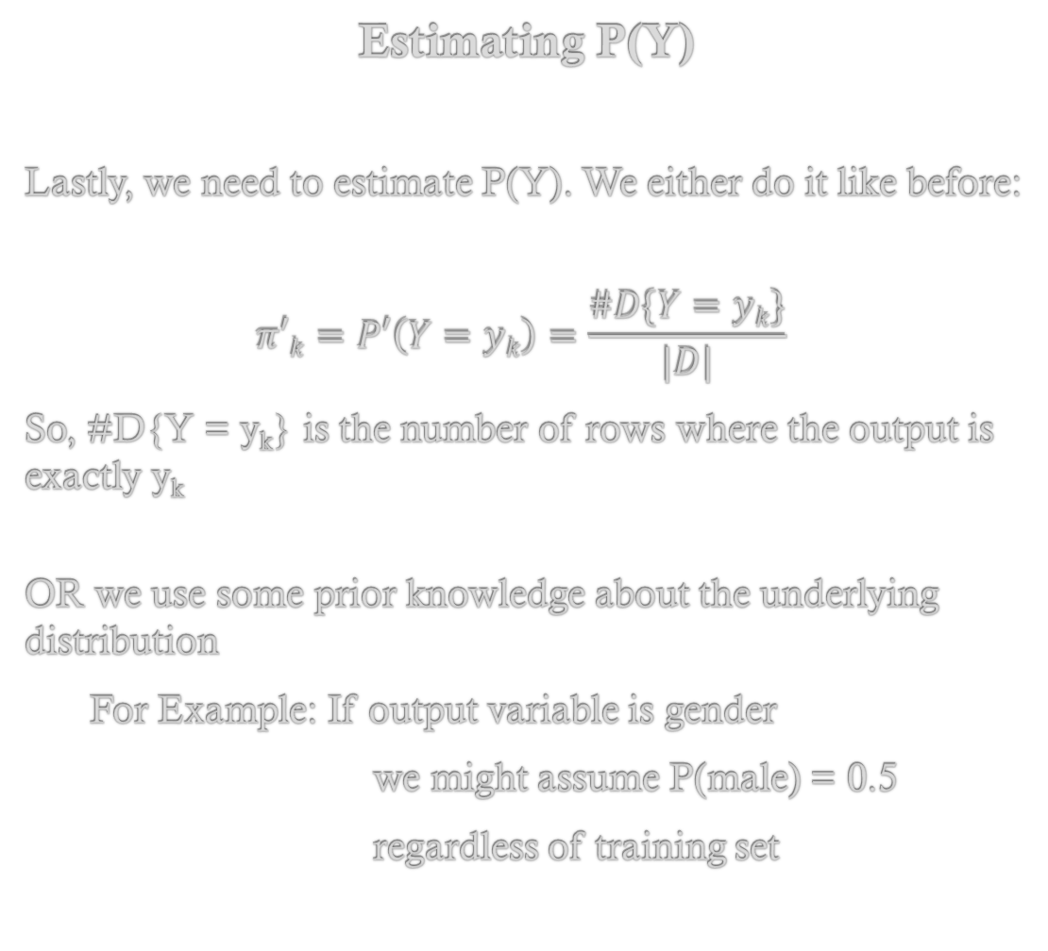
Estimating P(Y)
Lastly, we need to estimate P(Y). We either do it like before:
$$π′k=P′\left(Y=yk\right)=\frac{\#D\{Y=yk\}}{|D|}$$
So, #D{Y = y_{k}} is the number of rows where the output is exactly y_{k}
OR we use some prior knowledge about the underlying distribution
For Example: If output variable is gender
we might assume P(male) = 0.5
regardless of training set
Y (Output Variable)
X₁
X₂
X₃
…
X₄

Slide 23
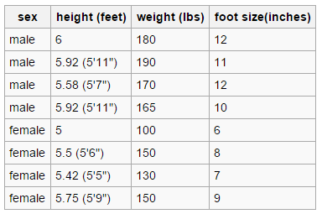
Example: Predicting Gender
Let’s look at a specific example: From Wikipedia
Male vs. Female
height
weight
foot size

Slide 24
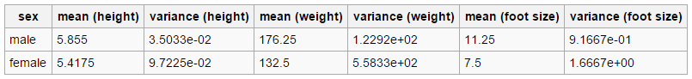
Example: Predicting Gender
Let’s look at a specific example: From Wikipedia
Male vs. Female
height
weight
foot size
*These computed using mean and variance formulas from earlier

Slide 25
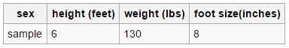
Example: Predicting Gender
Let’s look at a specific example: From Wikipedia
Male vs. Female
*Now we want to estimate the gender of this new sample
height
weight
foot size
*These computed using mean and variance formulas from earlier

Slide 26
Example: Predicting Gender
Let’s look at a specific example: From Wikipedia
Male vs. Female
*Now we want to estimate the gender of this new sample
height
weight
foot size
*Compute these and see which is larger. Formula from graph structure

Slide 27
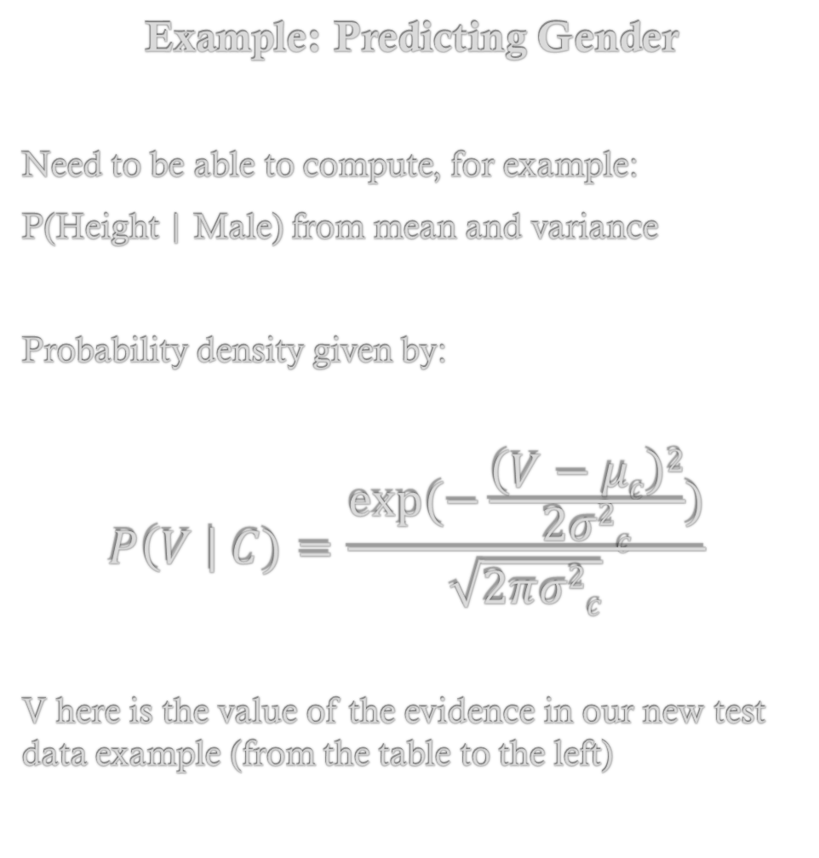
Example: Predicting Gender
Need to be able to compute, for example:
P(Height | Male) from mean and variance
Probability density given by:
$$P\left(V \right| C)=\frac{exp⁡(−\frac{\left(V−μc\right)2}{2σ2c})}{\sqrt{2πσ2c}}$$
V here is the value of the evidence in our new test data example (from the table to the left)
*Now we want to estimate the gender of this new sample

Slide 28
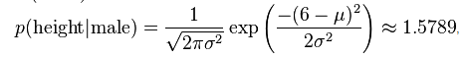
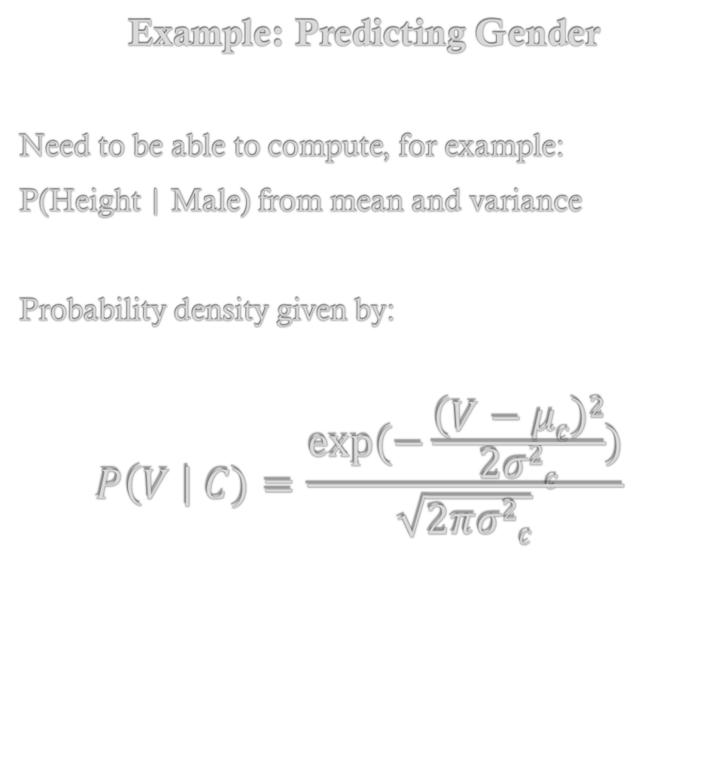
Example: Predicting Gender
Need to be able to compute, for example:
P(Height | Male) from mean and variance
Probability density given by:
$$P\left(V \right| C)=\frac{exp⁡(−\frac{\left(V−μc\right)2}{2σ2c})}{\sqrt{2πσ2c}}$$
*Now we want to estimate the gender of this new sample
The 6 in equation here comes from test data under height
The mean and variance comes from mean and var. of height
given in the table below (computed earlier)

Slide 29
Example: Predicting Gender
*Now we want to estimate the gender of this new sample

Slide 30
Example: Predicting Gender
*Now we want to estimate the gender of this new sample
Given these estimated mean and variance values

Slide 31
Example: Predicting Gender
*Now we want to estimate the gender of this new sample
Given these estimated mean and variance values
*Compute these and see which is larger. Formula from graph structure
Notice that evidence is same for both, so no need to compute

Slide 32
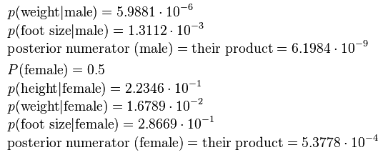
Example: Predicting Gender
Posterior value for male is lower than for female, so we predict this is a female.

